Slide 1
How to make a direct link to an Alma Digital file via an Alma Analytics report
Yoel Kortick
Senior Librarian

Slide 2

Agenda
Introduction
Step one – get the syntax for your institution
Step two – create the Alma Analytics report
Step three – Test the results

Slide 3
Introduction

Slide 4
Introduction
In this presentation we will show how to make an Alma Analytics report which includes a link to a digital file.
Note that the link will bring the user to the “View” of the digital file, however if the access rights requires that the user be logged into Primo then a message to log in will appear.

Slide 5
Step one – get the syntax for your institution

Slide 6
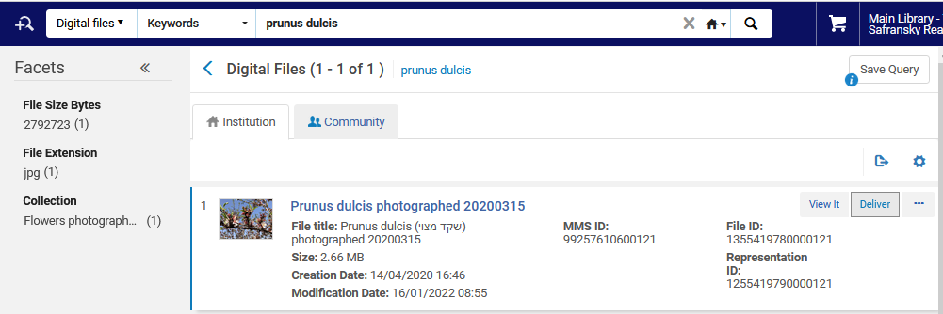
Step one – get the syntax for your institution
The first step is to get the syntax of the URL for your institution when accessing a digital file
Search Alma for the Digital File and click “Deliver”

Slide 7
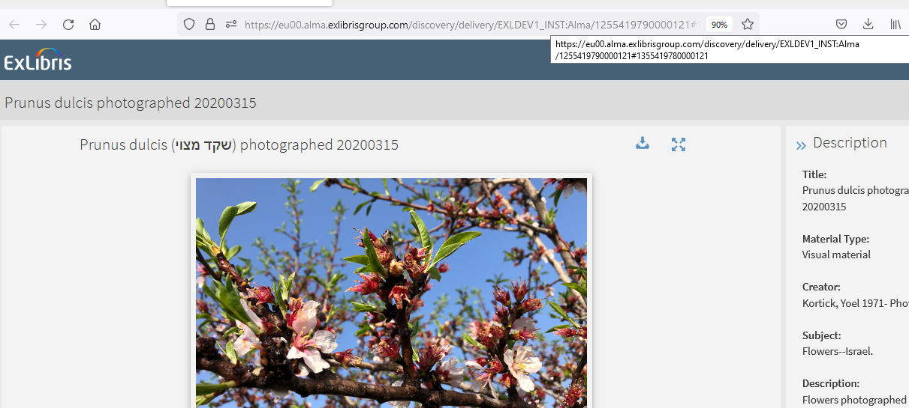
Step one – get the syntax for your institution
Take note of the URL

Slide 8
Step one – get the syntax for your institution
Take note of the URL syntax. It is a permanent text at the beginning of the URL, then a slash and the Representation ID, then a number sign and the File ID
Permanent text (this will be different in your institution)
Representation ID
https://eu00.alma.exlibrisgroup.com/discovery/delivery/EXLDEV1_INST:Alma/1255419790000121#1355419780000121
Number sign
File ID

Slide 9
Step two – create the Alma Analytics report

Slide 10
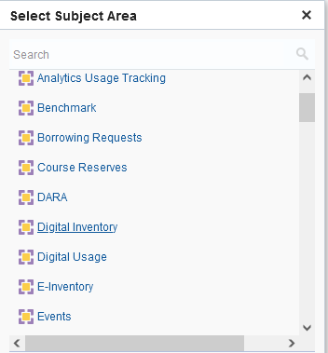
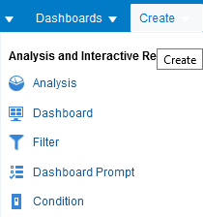
Step two – create the Alma Analytics report
In Alma Analytics create a new report in the Digital Inventory subject area

Slide 11
Step two – create the Alma Analytics report
Add whatever field(s) you want to display in the report, and also add the "Rep Id“ from the "Representation Details" folder.
It is recommended also to filter by:
  "File Lifecycle" (from the "File Details" folder) is equal to / is in Active
  AND
  "Bibliographic Lifecycle" (from the "Bibliographic Details" folder is equal to / is in In Repository

Slide 12
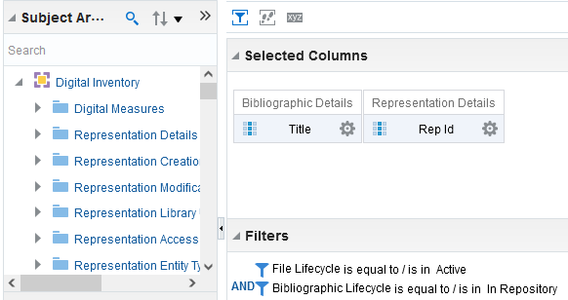
Step two – create the Alma Analytics report
Here is the initial analytics report

Slide 13
Step two – create the Alma Analytics report
We will now change the “Rep Id” to be the syntax of the link to the digital file. It will be
  The permanent text at the beginning of the URL (this will be different in your institution than what we will show here)
  A slash
  The Representation ID
  A number sign
  The File ID
To learn more about concatenating several fields together see How to concatenate two or more fields in an Alma Analytics report

Slide 14
Step two – create the Alma Analytics report
Our syntax will be as follows:
'https://eu00.alma.exlibrisgroup.com/discovery/delivery/EXLDEV1_INST:Alma/' || "Representation Details"."Rep Id" || '#' || "File Details"."File Id"

Slide 15
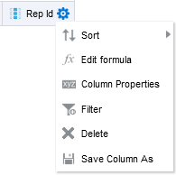
Step two – create the Alma Analytics report
On the Rep Id do “edit formula”

Slide 16
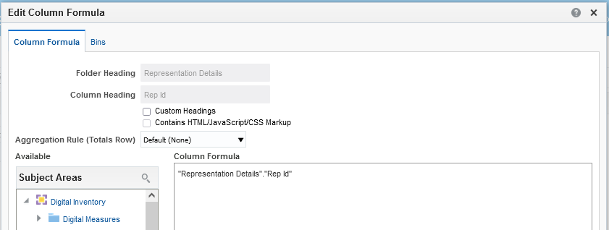
Step two – create the Alma Analytics report
You will see this

Slide 17
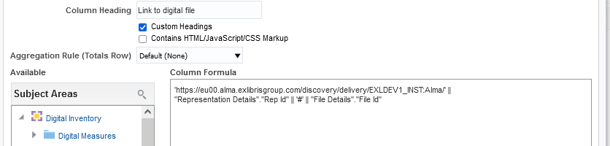
Step two – create the Alma Analytics report
Change it to this
Call the column whatever you want
The syntax we already saw

Slide 18
Step three – test the results

Slide 19
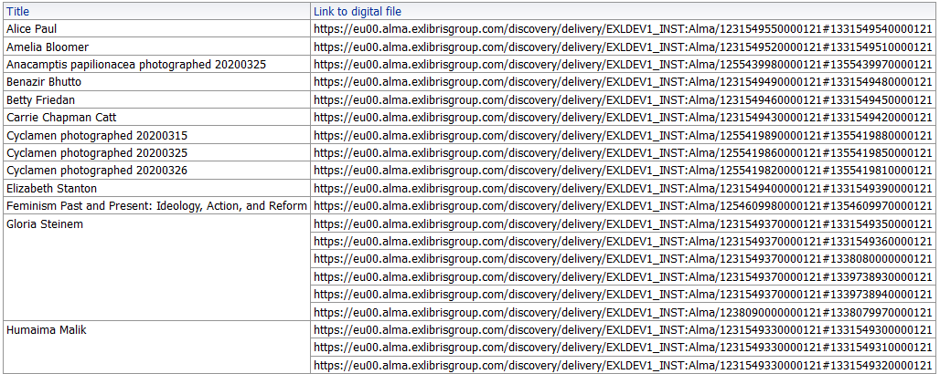
Step three – Test the results
Now we have a report with the title and link to the digital file(s)

Slide 20
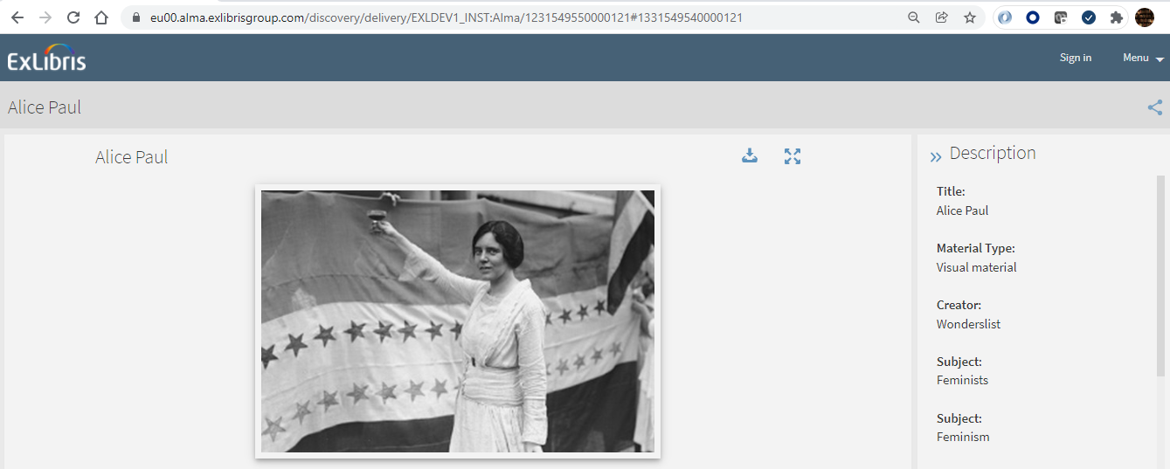
Step three – Test the results
Here is the first example (Alice Paul)

Slide 21
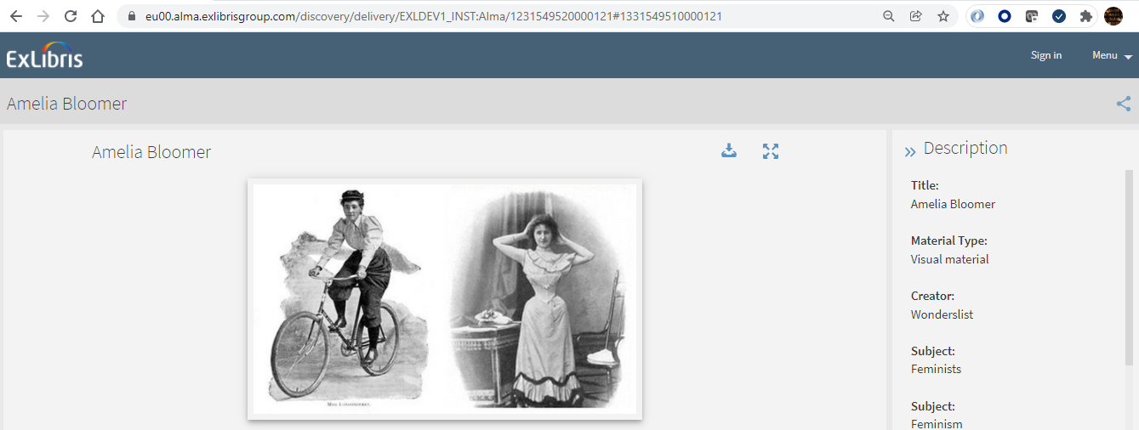
Step three – Test the results
Here is the second example (Amelia Bloomer)

